Slide 1

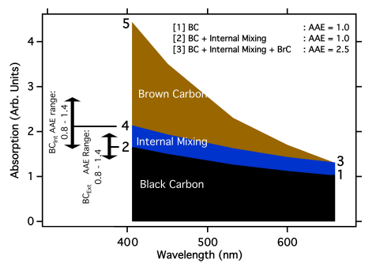
On the attribution of black and brown carbon light absorption using
the Ångström exponent

Slide 2

3 A case study for BrC attribution
3.1 Methods
Background
Data were collected during a dense biomass burning event where emissions were sampled 24 h after the start of a ponderosa pine forest fire near Boulder, Colorado, during September 2010.
Particle emissions were dominated by BC and organics. Organic compounds consistently accounted for > 90% of non-BC particle mass (Mnon−BC).

Slide 3

3 A case study for BrC attribution
3.1 Methods
A PAS (photoacoustic aerosol absorption spectrometer) measured dry total absorption at 658 nm and 404 nm (bAbs−658, bAbs−404) and thermal-denuded absorption at 404 nm
The thermal denuder heated the sample flow to 200 °C and removed the majority of semi-volatile coatings.
The experimentally observed total non-BC MAE was determined using Eq. (2), and includes contributions from both BCInt and BrC (MAEBCInt+BrC).

Slide 4
3 A case study for BrC attribution
3.1 Methods
The AAE attribution method was applied to the same data set to determine the MAE using four different AAE values for BCInt: 0.55 to 1.0
All AAEs used were for the wavelength pair 404 nm and 658 nm.

Slide 5
3 A case study for BrC attribution
3.2 Results
In this section we compare BrC absorption values derived from both direct attribution and AAE methods. All absorption values are presented using the MAE
Absorption measurements for this forest fire revealed significant contributions from both internal mixing of BC and absorption by BrC to total absorption (Fig. 3).

Slide 6
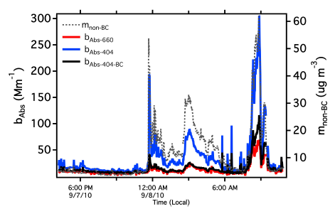

www.themegallery.com

Slide 7
3 A case study for BrC attribution
3.2 Results
The two AAE-independent MAE values (MAEBCInt+BrC and MAEBrC) are compared to those calculated using the AAE attribution method.
Histograms of all MAEs are shown in Fig. 4
The mean and standard deviations shown in Table 1.
The best agreement between the AAE attribution method and MAEBrC is obtained using AAE=1 (average MAEAAE−1.0 is 1% lower than MAEBrC).
Using the most probable range of AAE values for BCInt found in literature (1.1±0.3), the potential differences between the AAE modelled MAE and MAEBrC were +20% to −60% (interpolated from 1MAE% in Table 1).

Slide 8
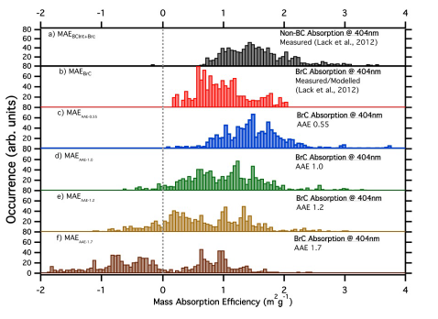
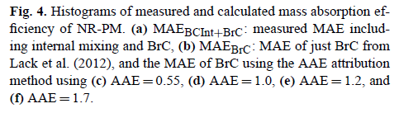
www.themegallery.com

Slide 9
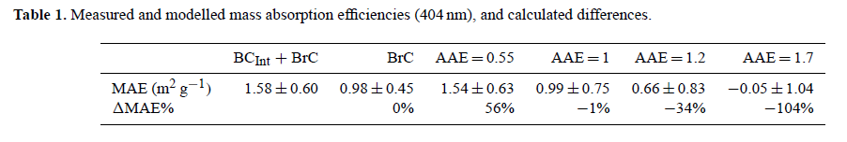
Using this information the mean difference was calculated (ΔMAE% shown in Table 1). A negative ΔMAE% indicates that, on average, the attributed MAE was less than MAEBrC.
The mean does not provide a truly representative statistic for comparing trials. However, despite this limitation it still serves as a useful general metric.
The attributed MAEAAE−1.0, MAEAAE−1.2, and MAEAAE−1.7 all show values below zero, with the fraction of MAE values < 0 increasing with the assumed AAE used

Slide 10
3 A case study for BrC attribution
3.2 Results
These results provide some indication of the range of uncertainty that arises from the choice of AAE used for BrC absorption attribution.
At worst, differences of 50% to 100% in attributed MAE were observed in this case study.
Even when using our best estimate of the true BCInt AAE for this case study, an average disagreement of 34% between cases was found.

Slide 11
4 Summary
The attribution of short-wavelength light absorption to black and brown carbon has commonly been achieved using the absorption Ångström exponent (AAE) relationship, assuming an AAE for externally mixed black carbon (BCExt) of unity, and assuming that internal mixing of BC (BCInt) does not alter AAE.
For the biomass-burning case study presented, which is the most likely environment for the occurrence of strongly absorbing BrC, 60% to 80% o absorption was due to BrC, making the AAE attribution method viable.

Slide 12
4 Summary
When using an AAE of 1, as is often done, the average difference between the BrC mass absorption efficiency (MAE) calculated using the AAE and AAE-independent method was close to zero.
However, the use of AAE=1 for this system was likely not justified, given that the system contained BC coated in significant amounts of organic matter, which would have yielded an AAE (without the inclusion of brown carbon absorption) of at least 1.2. When this AAE was used to attribute absorption, an underestimation in BrC MAE of −34% was found.

Slide 13
4 Summary
Absorbing particles emitted from the same source will likely display a range of AAE based upon size, coatings and composition, which is very likely to change as atmospheric transport and processing occurs.
We therefore caution against the general application of the AAE method for absorption attribution without careful consideration of uncertainty propagation. In order to minimize uncertainties, the technique should only be applied when a significant fraction of the total absorption is sourced from BrC, and when the AAE of BCExt or BCInt is constrained.

Slide 14
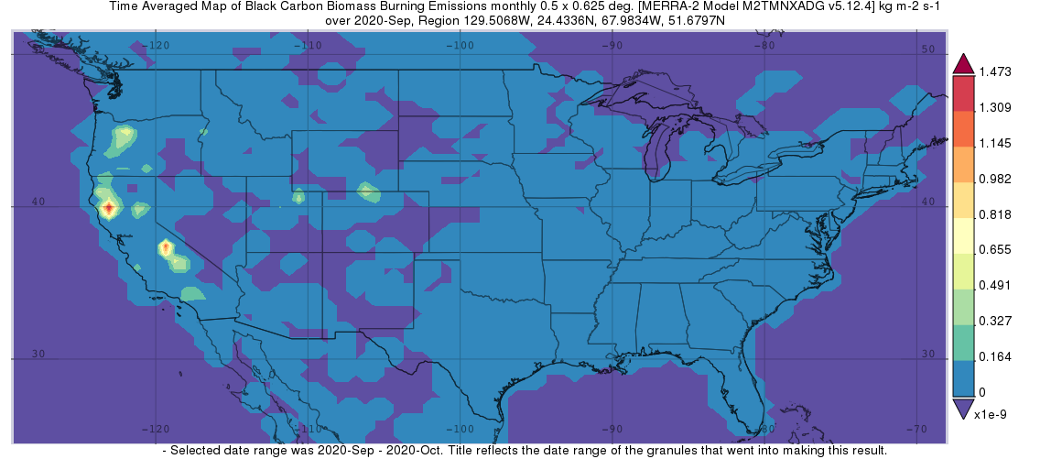
Satellite Imagery Wildfires from California example

Slide 15
